Slide 1
Sales Dashboard
Analysis of Cash, EMI, and When EMI Not Available by Shop & Month
By Akash Singh

Slide 2
Data Summary
Dataset size: 30 rows × 5 columns
Columns: Shop Name, Month, EMI, Cash, EMI Not Available
Shops: Multiple (e.g., Manish Mobile Shop, etc.)
Months covered: Jan → Jun
Key insights:
Each row shows a shop’s sales split into EMI, Cash, and When EMI Not Available for a month.

Slide 3
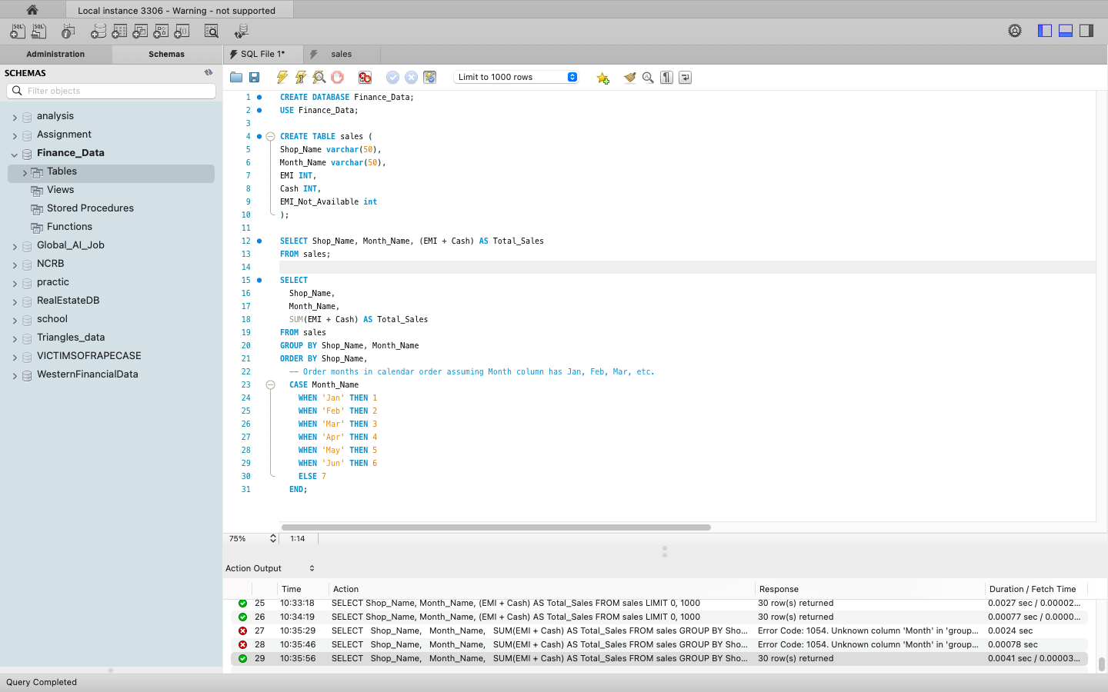
SQL Analysis

Slide 4
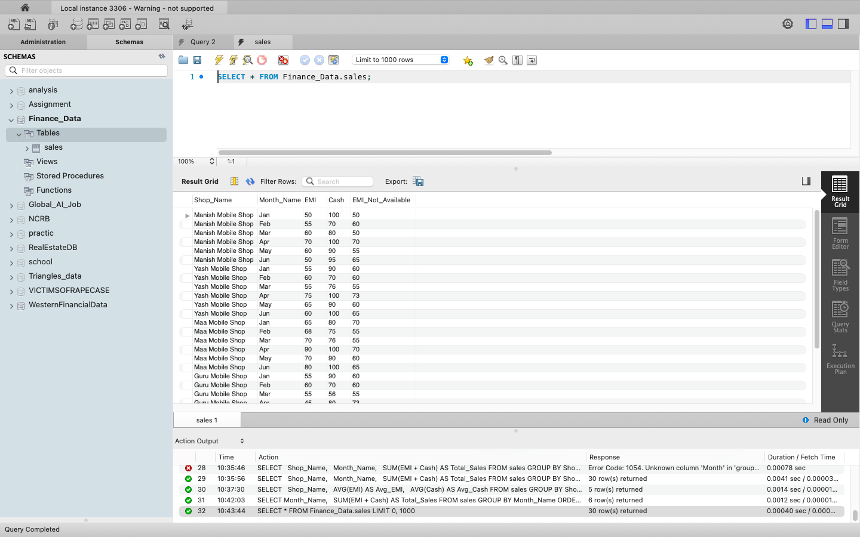

Slide 5
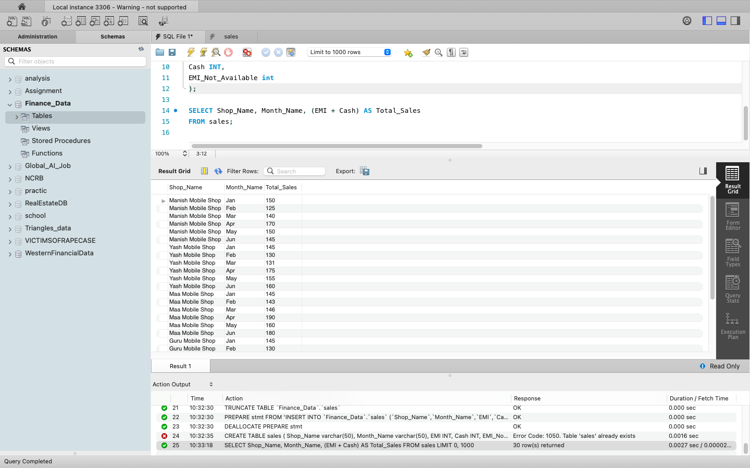

Slide 6
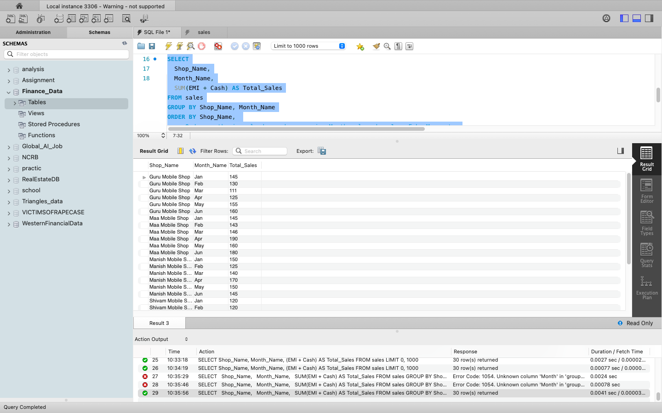

Slide 7
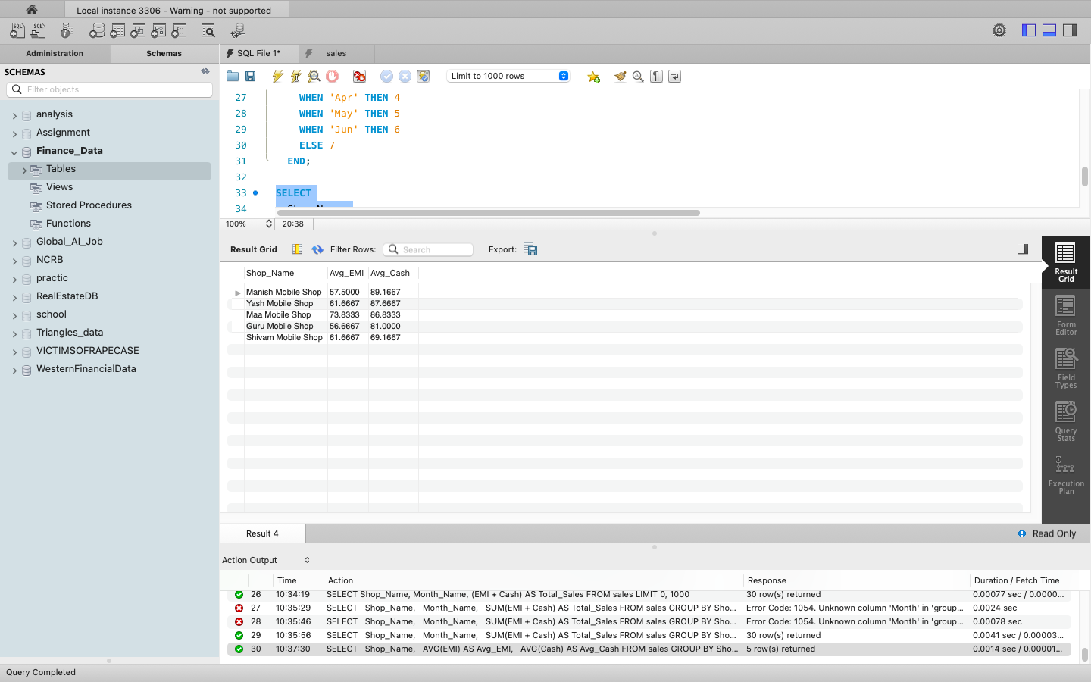

Slide 8
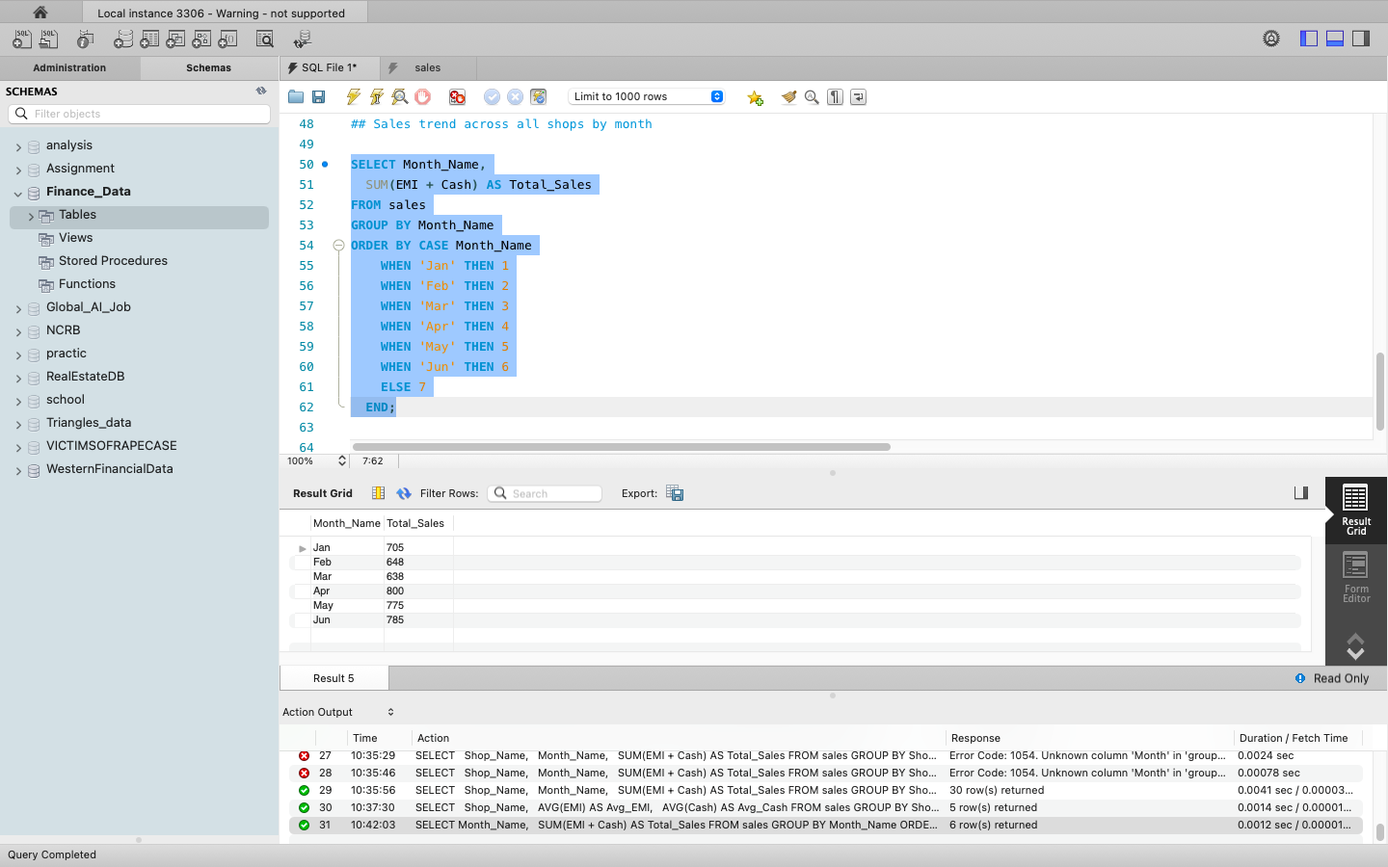

Slide 9
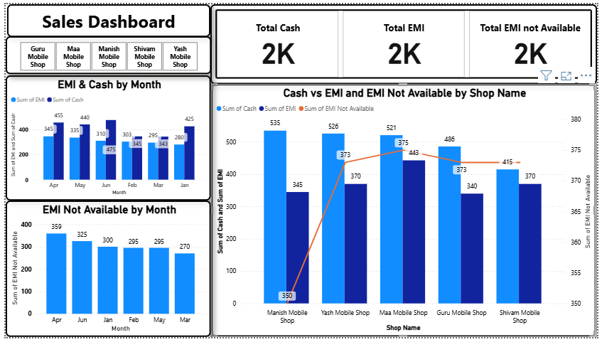
Dashboard Overview

Slide 10
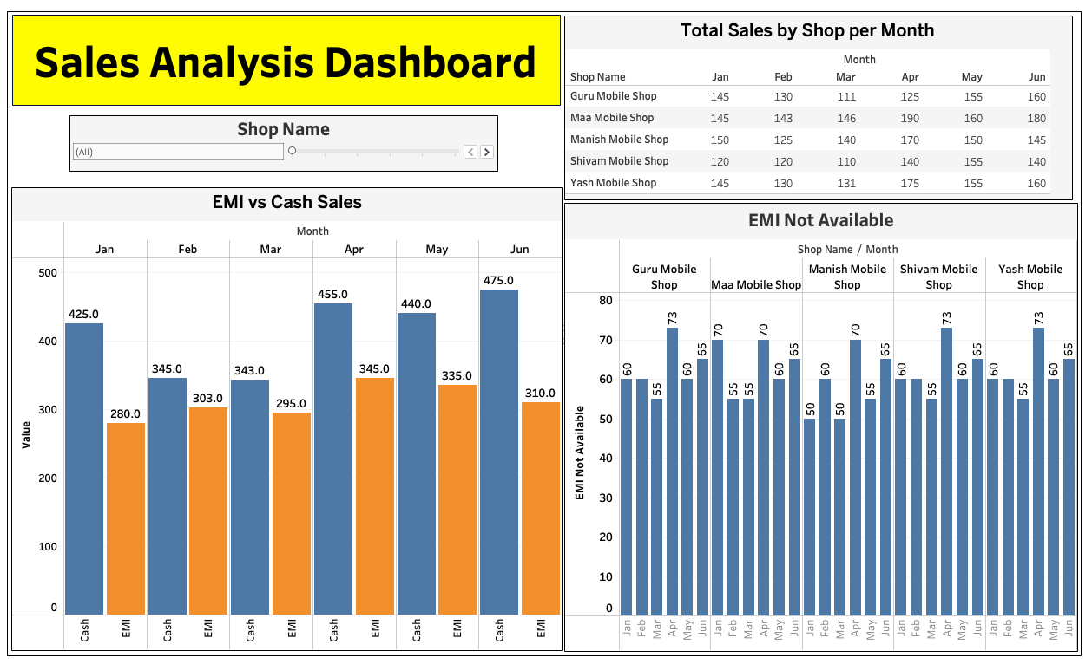
Dashboard

Slide 11
Key Insights:-
Total Cash, EMI, and When EMI Not Available each stand at ~2K.
Maa Mobile Shop and Yash Mobile Shop lead in Cash & EMI.
EMI and Cash show a steady trend from Jan–Apr, with March having highest Cash (425).
When EMI Not Available is highest in April (359) and lowest in March (270).
Manish Mobile Shop shows highest Cash (535), while Yash Mobile Shop has highest EMI (526).
When EMI Not Available is lowest at Manish Mobile Shop (350).
Overall, shops maintain balanced performance across payment modes.

Slide 12
Key Takeaways
Overall Performance
Total Cash, Total EMI, and Total EMI Not Available are almost equal (~2K each), showing balanced sales across payment modes.
March was the best month overall, with the highest Cash and lowest “EMI Not Available.”
Manish and Yash Mobile Shops are top performers, excelling in Cash and EMI respectively.
Monitoring “EMI Not Available” closely could improve reporting accuracy, especially for April.

Slide 13
Monthly Trends
Cash collections rose steadily from Jan (280) to Mar (425), peaking in March.
EMI values stayed fairly stable (around 310–345) with slight growth in March.
EMI Not Available was highest in April (359) and lowest in March (270), indicating March had the best data completeness.

Slide 14
Shop-wise Insights
Manish Mobile Shop has the highest Cash (535) and the lowest EMI Not Available (350), showing strong, clean transactions.
Yash Mobile Shop leads in EMI (526) and maintains healthy Cash flow.
Maa Mobile Shop is consistent in both Cash (521) and EMI (443).
Guru Mobile Shop shows moderate values across all modes (Cash 486, EMI 373).
Shivam Mobile Shop has balanced results (Cash 415, EMI 370).

Slide 15
We appreciate your time reviewing the Sales Dashboard Insights. Questions & feedback are welcome.
Thank You

